Slide 1

BBA 2nd SEM Case Study – Jeff Bezos
Submitted By Shankh Bansal
AU22C1013
Submitted To
Dr. Nitin Sharma

Slide 2

Index
About Jeff Bezos
Swot analysis of Jeff Bezos
Leadership style of Jeff Bezos
About Amazon
Reason behind Success
Swot Analysis of Amazon
Competitors
Learnings
Conclusion

Slide 3
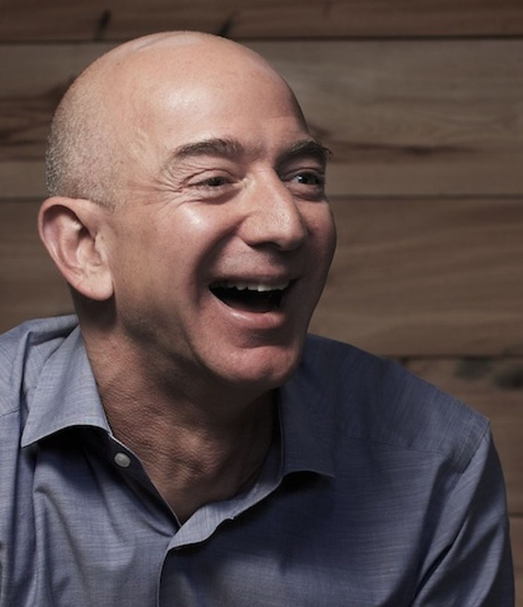
Early life
Jeff Bezos was born on January 12, 1964, in Albuquerque, New Mexico, to a teenage mother, Jacklyn Gise Jorgensen, and his biological father, Ted Jorgensen.
Bezos's parents divorced within a year, and when Bezos was four years old his mother married his step-father Mike Bezos, a Cuban immigrant.
Brad Stone argues, that the fact of being adopted gave Bezos a powerful motivation to succeed like other technology icons, Steve Jobs and Larry Ellison.
Interested in how things work- at the age of three, disassembled his crib with a screwdriver because he insisted on sleeping in an ordinary bed.
Bezos had an early love of computers and studied computer science and electrical engineering at Princeton University.

Slide 4
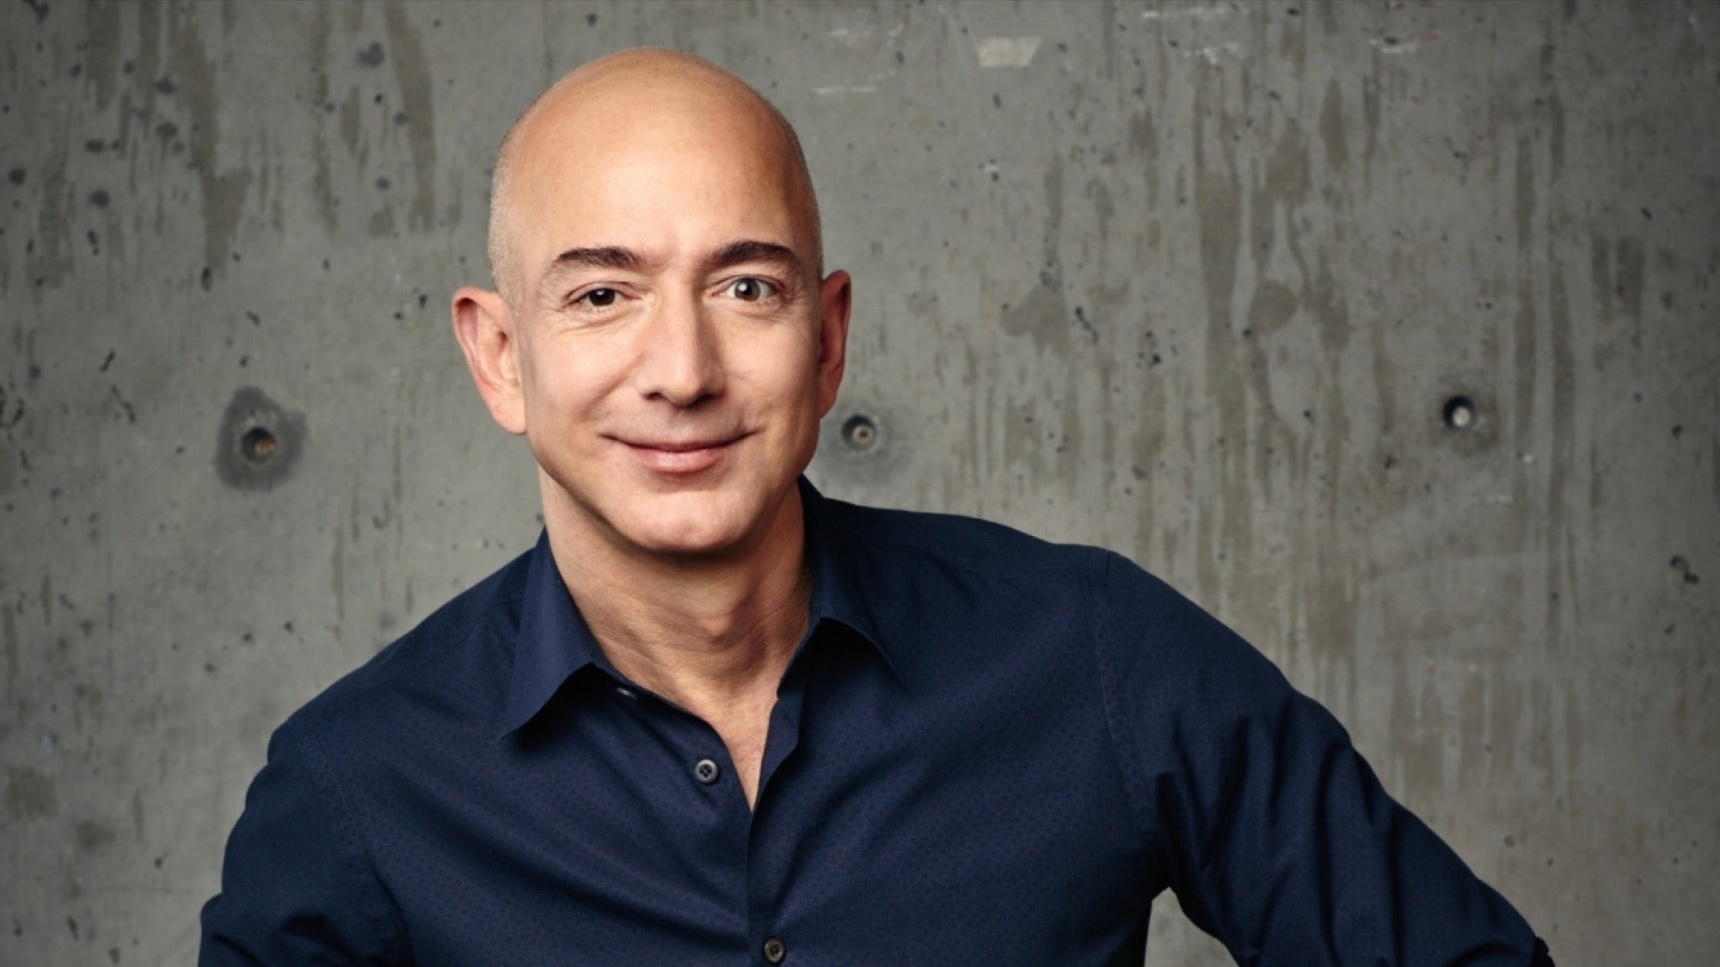
Visionary
Strategy
Leadership
Creative
Relentless
Ruthless

Slide 5
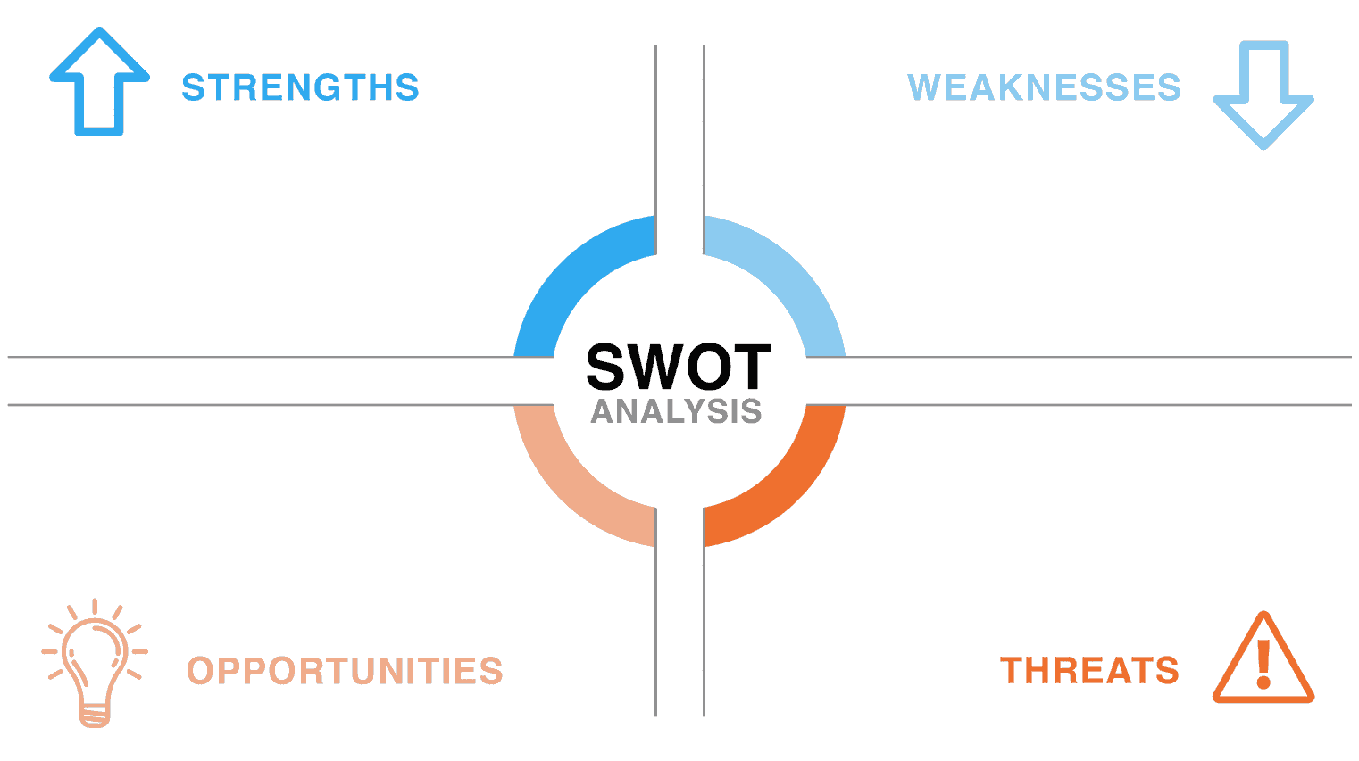
Has a very broad VISION.
Takes decision with fresh mind.
Never give up attitude.
Always have a strategy in mind.
Hard work, Dedication & passion are the key to success.
Was not willing to take chances when comes in investment.
Launching too many business by getting influenced by others business.
Apathetic in relationship.
Parsimonious.
Employees are undervalued in the eyes of Jeff Bezos.
Jeff Bezos
AI smart wardrobe.
Amazon smart home.
Prime Air delivery.
Always open for investment.
Peoples trust issue.
Customer criticism.
International Regulatory rules.
Jebb behavior towards employee.
Threat of losing sellers.

Slide 6

Jeff Bezos Leadership Style.
Bezos is known to be a transformational and task-oriented leader. In order for Bezos to transform his company, he looked and still searches for ways to become innovative.
He is a leader known for planning and delivering results through creativity. With Bezos’ long-term goals and the public’s needs and wants, a connection is made to help serve customers.
Because of his ability to innovate and envision, he had been able to help his company grow and expand over time.

Slide 7
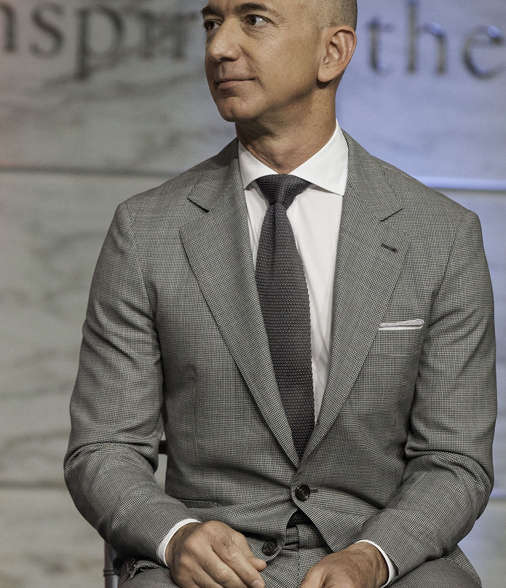
Awards
2008
Bezos was awarded an honorary doctorate in science and technology from Carnegie Mellon University in 2008.
2011
In 2011, The Economist gave Bezos and Gregg Zehr an Innovation Award for the Amazon Kindle.
2012
In 2012, Bezos was named Businessperson of the Year by Fortune.

Slide 8
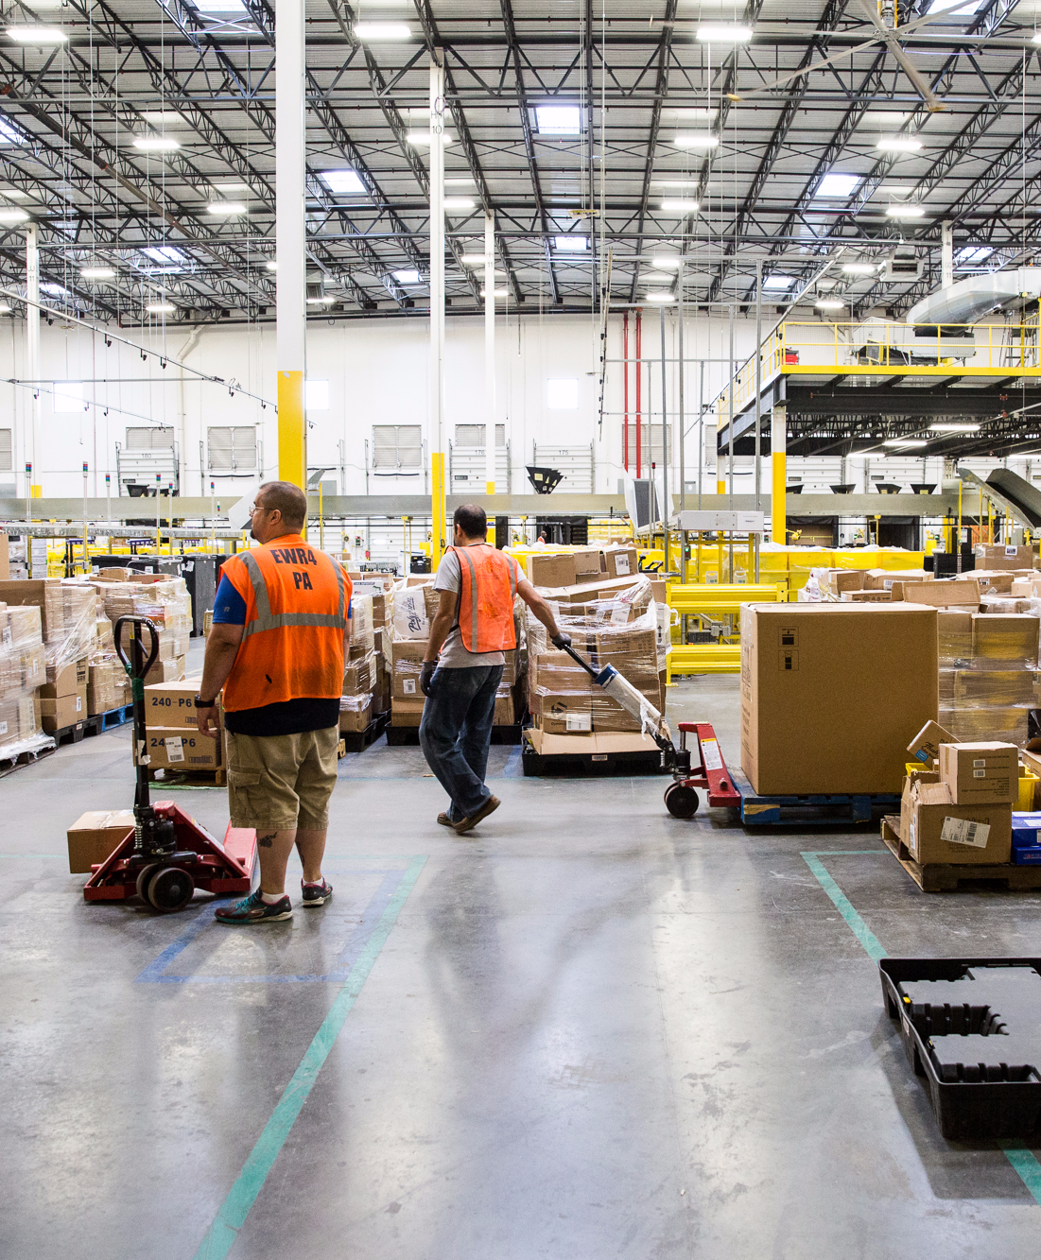
About Industry
Amazon is the leading U.S online e-commerce retailer consumer industry with a 23% market share more than its
Some of the major competitors including Wal-Mart. The market of online e-commerce retail is highly dominated by Amazon.
Top Competitors for Amazon includes Alibaba, Walmart, Otto, Priceline, E-bay, Flipkart, and Netflix.

Slide 9
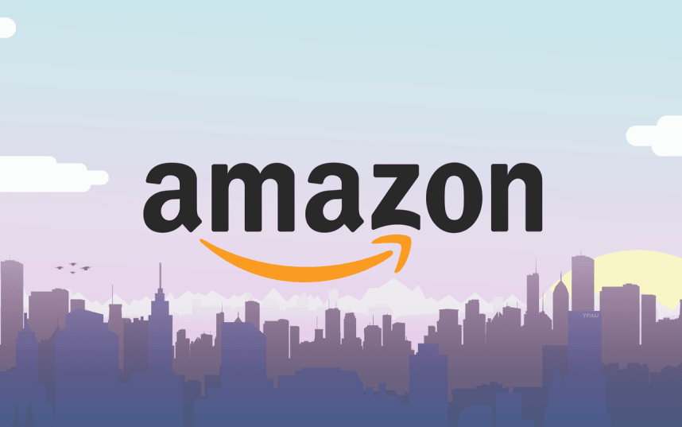
About Company
Amazon is an American electronic commerce and cloud company founded by Jeff Bezos on July 5' 1994.
It is a Washington based public company having it's headquarter at Seattle, Washington.
It is the largest internet retailer in the world and second largest in terms of total sales after Alibaba Group.

Slide 10

Reason Behind Succes
INNOVATION
CUSTOMER SERVICE
EXECUTION
DIVERSIFICATION
OUTSTANDING USER EXPERIENCES
MERGING DESIGN WITH CONTENT
AN “IN IT TO WIN IT” MINDSET

Slide 11
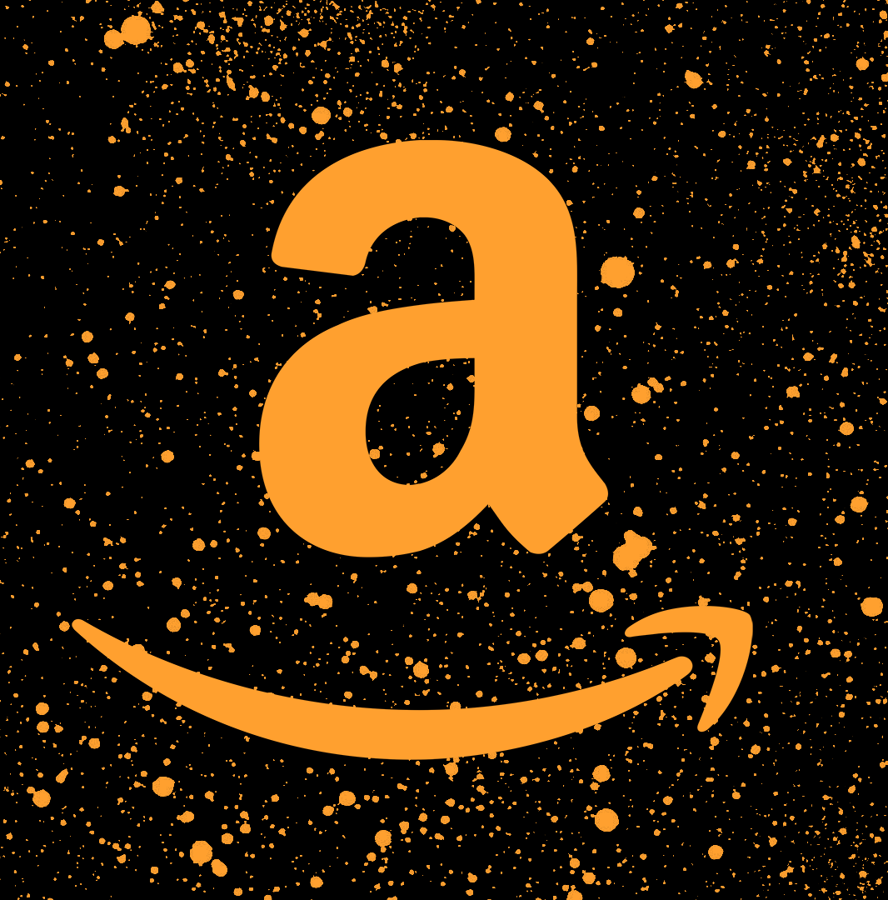
STP (Segmentation, Targeting, Positioning.)
Amazon has successfully positioned itself as a "Go global Act local" e-commerce giant where people can buy anything & get it delivered at any remote locations.
Using the catchphrases like #AurDikhao, #ApniDukan, #Amazon Wale in its most recent campaigns in India, it has further helped them acquire a distinct space in the consumer's mind.

Slide 12

Reason behind survival. Its 3Cs
Customer Analysis.
Competition Analysis.
Company Analysis.

Slide 13
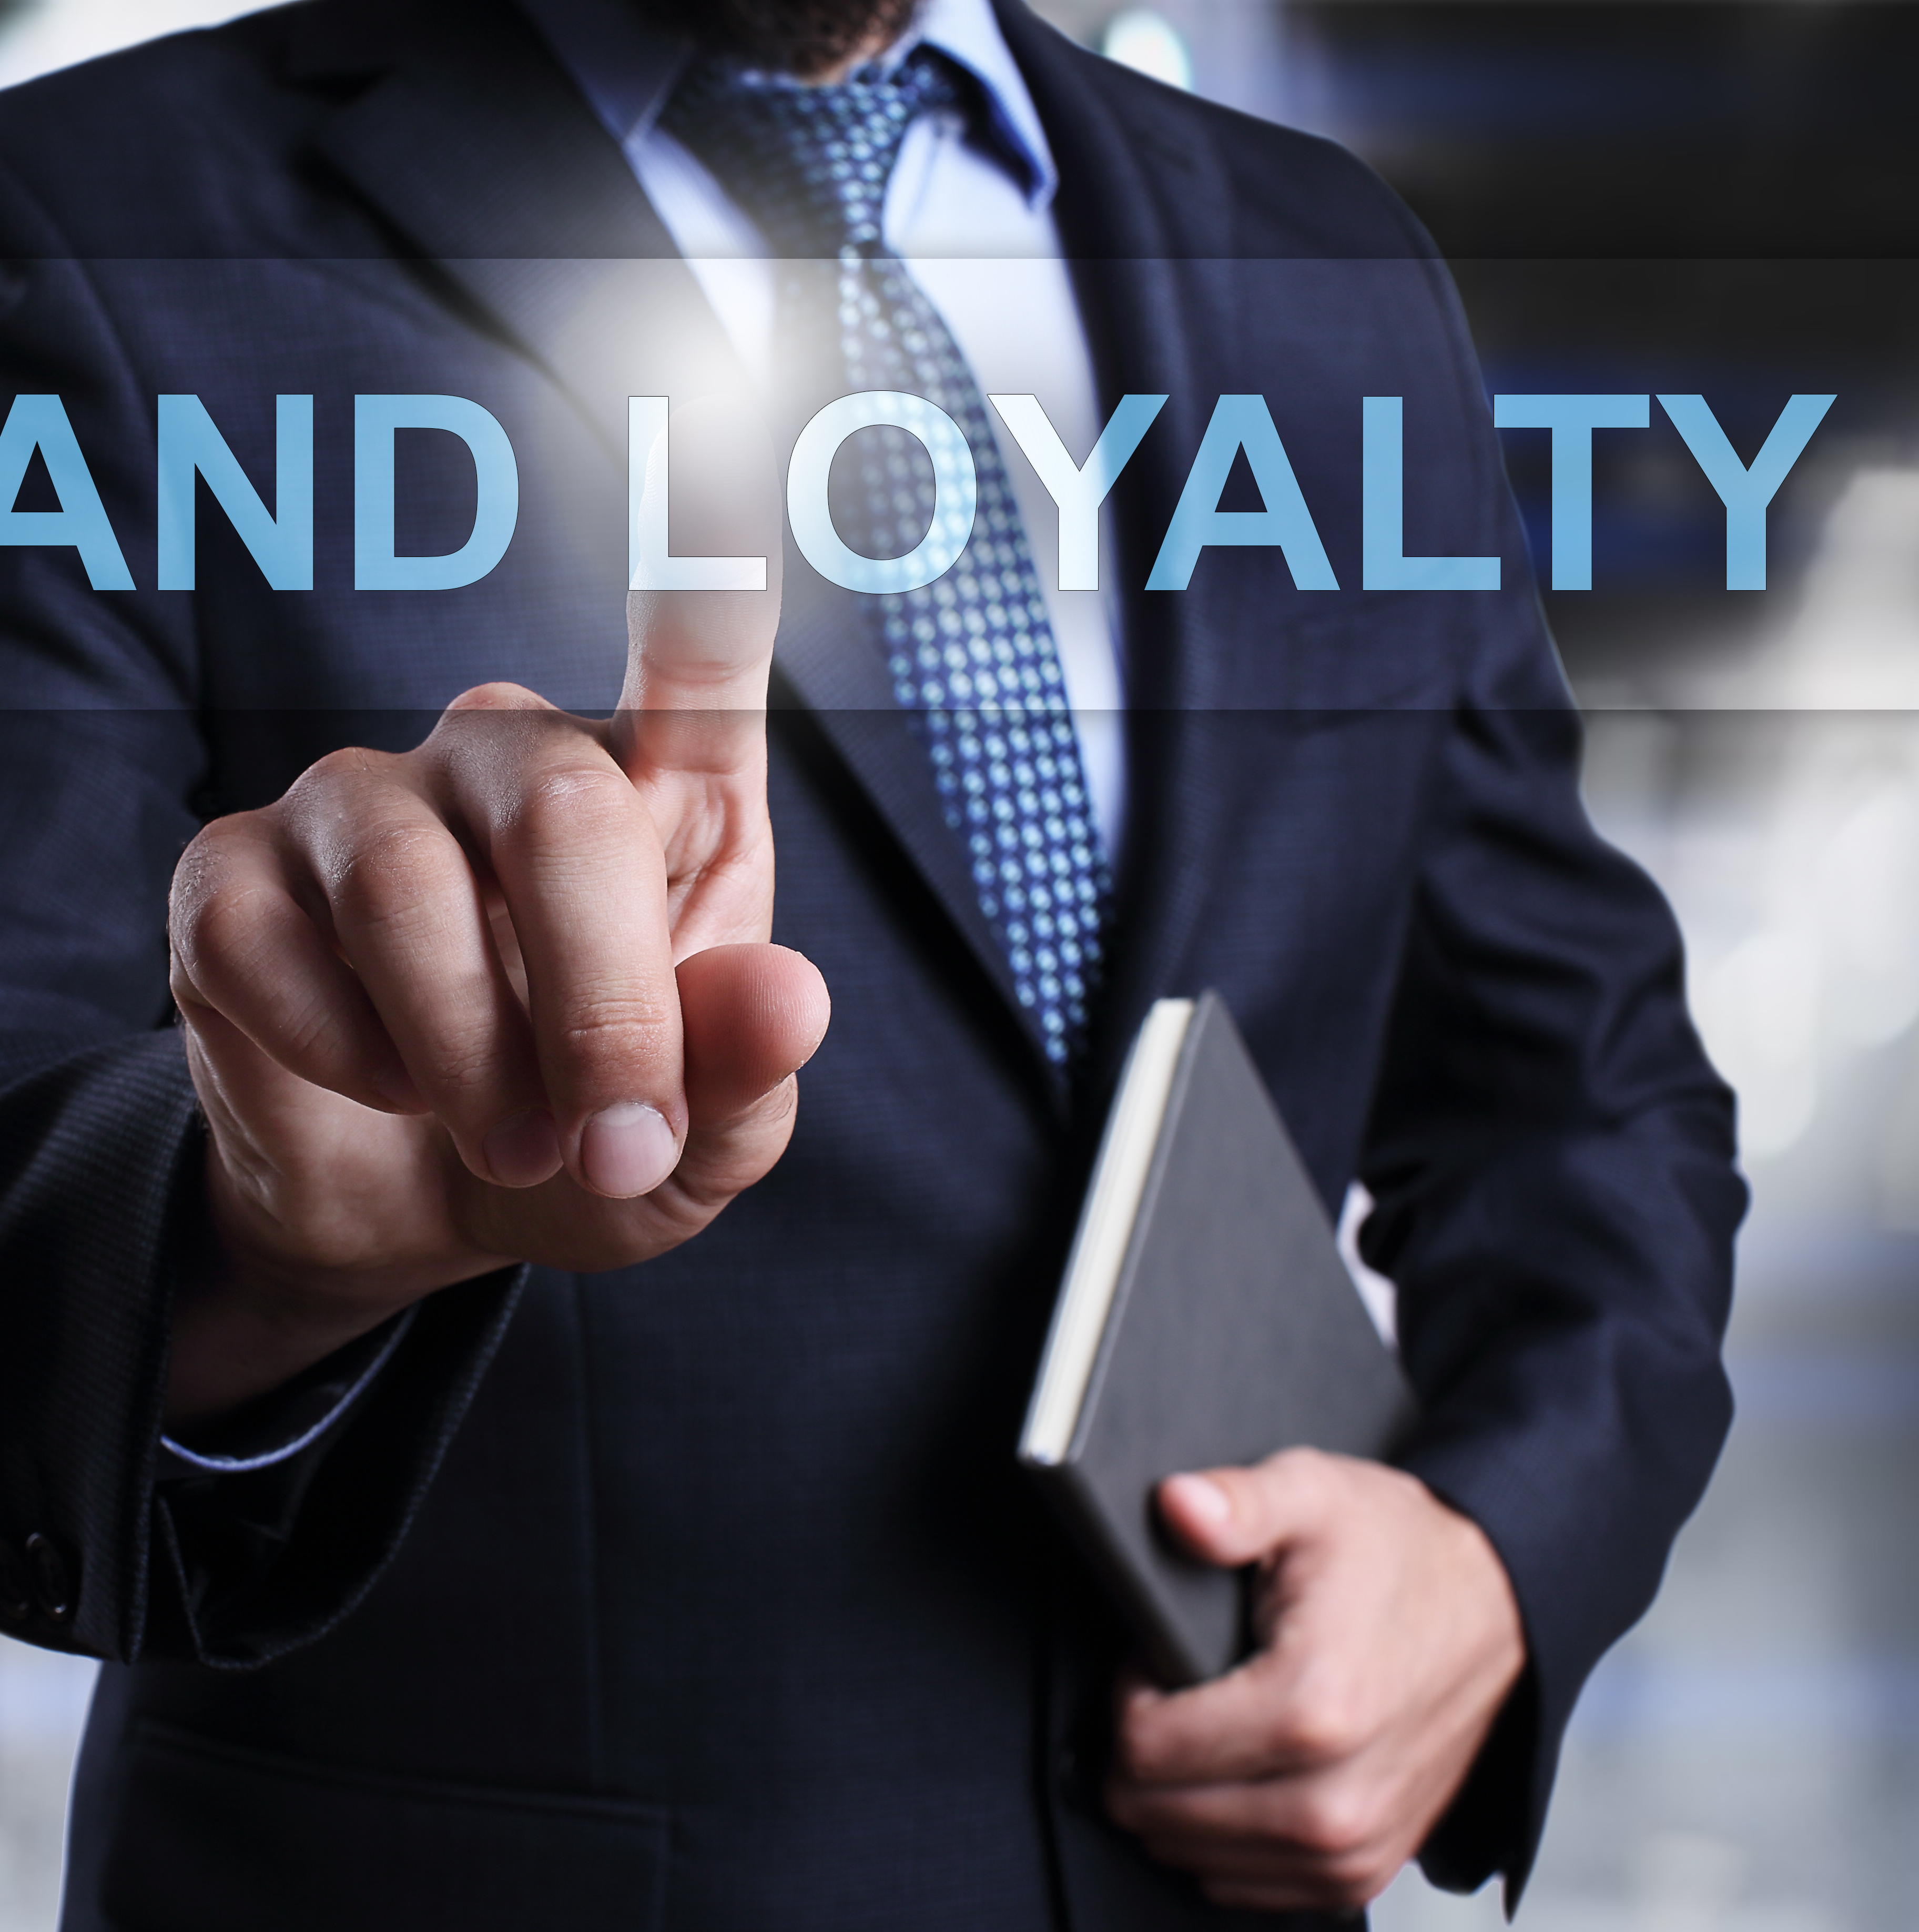
Brand Loyalty
Amazon has amazing brand loyalty.
The gap between the customer expectation and the potential value is less.
This is one of the reasons for customer loyalty for amazon.
Amazon always kept its promise of giving best quality products and on time delivery.
Amazon able to increase its revenue from 6.92 billion dollars in 2005 to 177.87 billion in 2017.
Prime services have enticed an estimated 70 million-90 million people to sign up for membership.

Slide 14
Brand well known along with a strong customer base in many parts of the world.
Diverse product offerings.
Free home delivery above a minimum purchase.
Working with minimum profit and gaining from economies of scale.
Strong business relationships with publishing houses, major electronic companies etc.
Operates at very low margin.
Criticism for its working conditions.
'KINDLE' is not up to the mark of its competitors.
Acquiring more small business enterprises, enabling them to expand.
Opening physical stores so as to give the customers a feel of touch and experience.
Indian retail industry is estimated to be $450 Billion .
Expand into more product segments.
Tie ups with major players of untapped market.
Online security threats.
Regional low-cost retailers.
Strong online presence of Indian competitors like Flipkart and Myntra.
Flexible rules against FDI enabling other major players like Walmart etc. to enter.
Amazon

Slide 15




Competitors
For retail: Alibaba, Target, eBay, Walmart, Flipkart.
For streaming services: Netflix, Apple TV, Disney+.
For cloud or web services: Alibaba Cloud, Microsoft Azure.

Slide 16
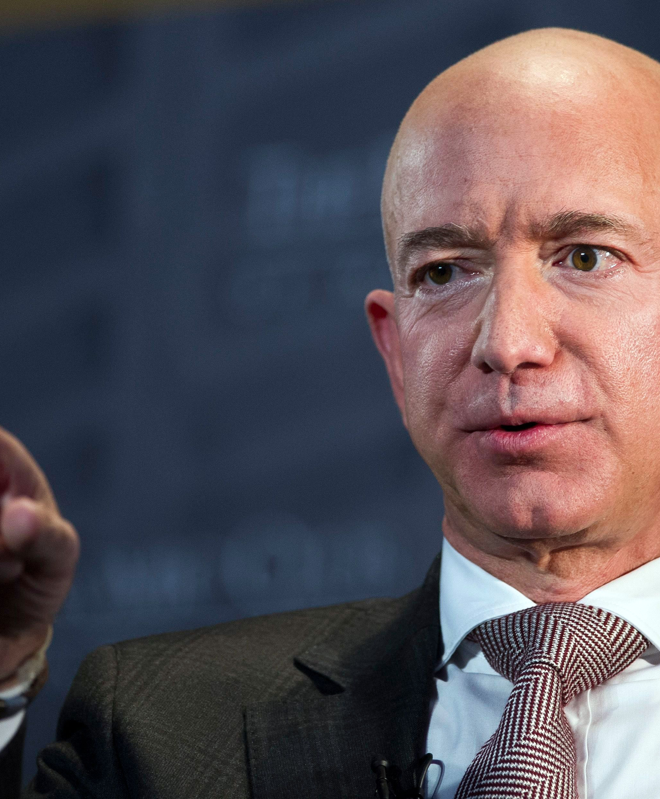
Learnings
Choosing to work hard is the key to being successful.
Don't be afraid to dream big — and shoot for the moon!
Think bigger than yourself to understand the needs around you.
Find success within the fires of adversity.
Don't let your circumstances define who you are or what you can achieve.

Slide 17

Conclusion
Amazon is a company that has grown exponentially from their e Bookstore beginnings. The internet boom certainly contributed to the success of Amazon. However, the company has found ways to stay innovative and relevant; Amazon has used their internet marketplace to help consumers and third party retailers buy and sell goods conveniently from the comfort of home. The company has a goal of same day delivery, that way buying something on Amazon will have no drawbacks. They have already accomplished two day and same day delivery to urban areas with their subscription based services. Amazon Prime Air will make it possible to send items out of the fulfillment center the same day without a third party delivery service which will cut down September - 18 – 2016 on the time it takes for the consumer to start using the items that they purchased. With the launch of Amazon Prime Air, the company will get closer and closer to their goal of same day delivery.

